Slide 1
TorchVision Object Detection Finetuning Tutorial

Slide 2
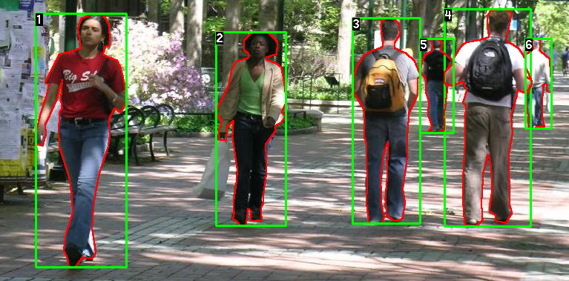

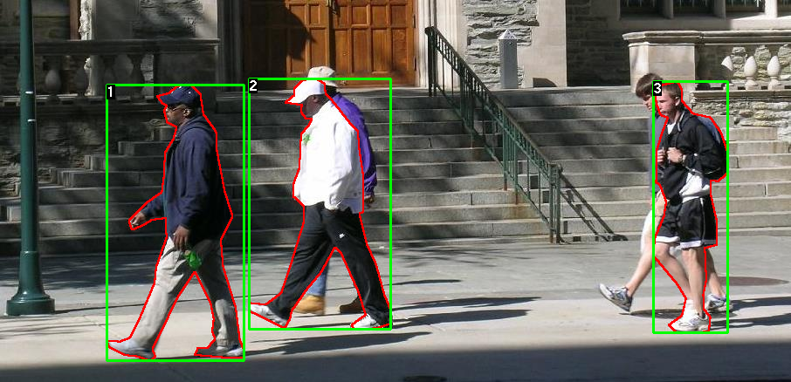

Penn-Fudan Database

Slide 3


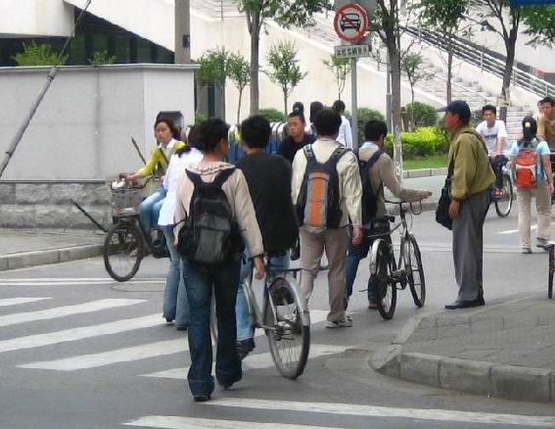

Training & OutPut

Slide 4







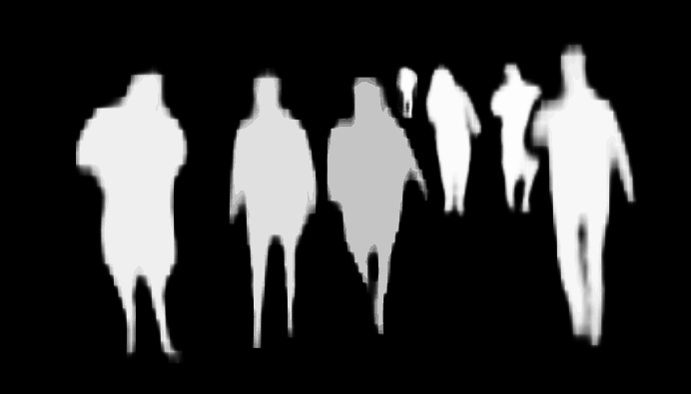
TorchVision Object Detection Finetuning Tutorial

Slide 5
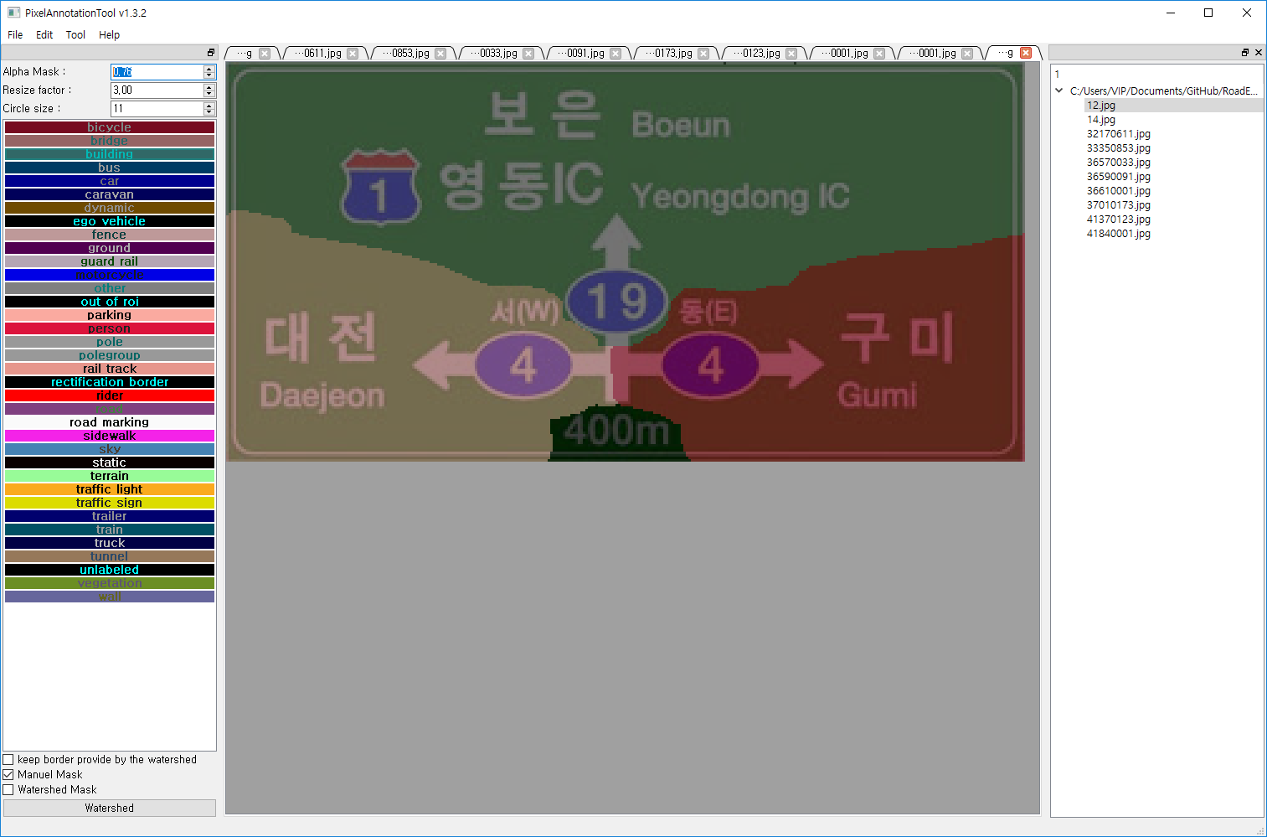
Custom Dataset

Slide 6


Custom Dataset

Slide 7
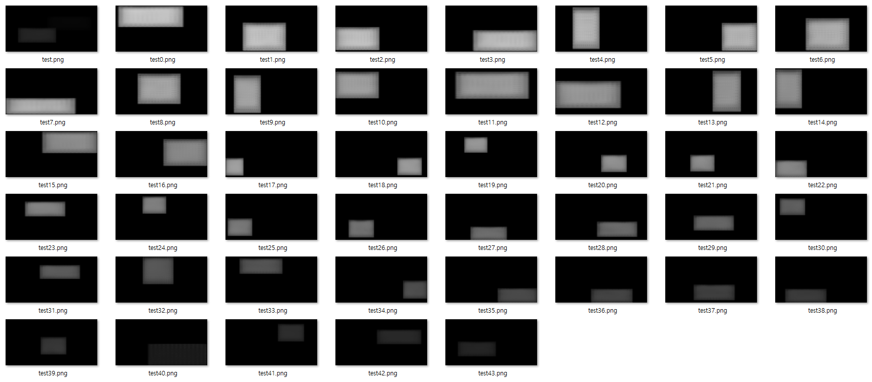
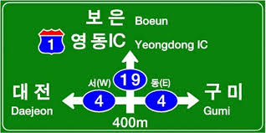
Custom Dataset Training

Slide 8

Custom Dataset Training

Slide 9
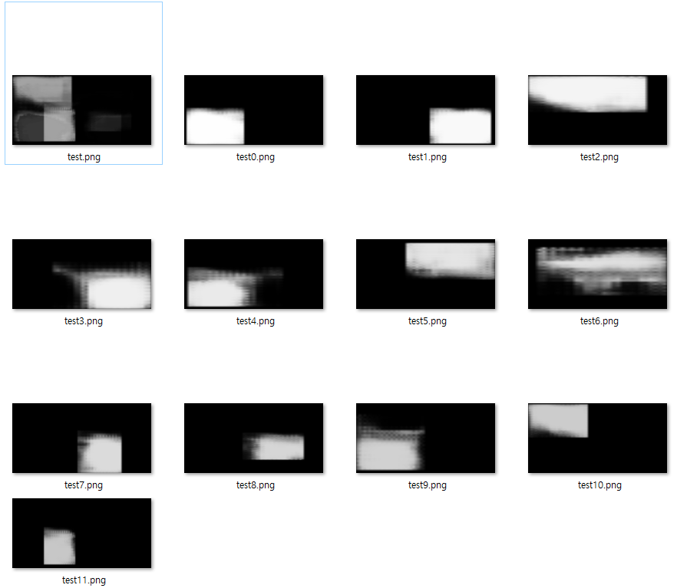

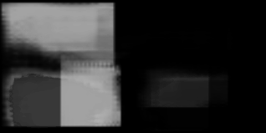
Custom Dataset Training

Slide 10

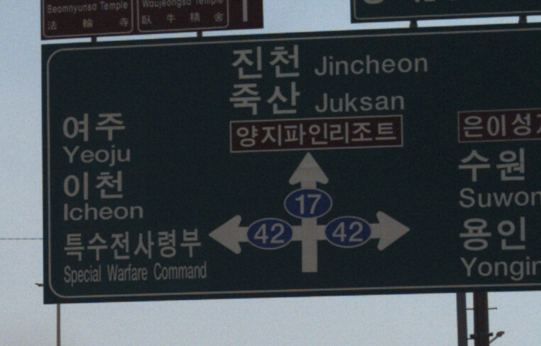


Custom Dataset Training

